Slide 1
WELCOME!
Have a seat anywhere
Put your bags in the cupboards in the back
3. When the bell rings, we will get started

Slide 2
Classroom Expectations & Procedures
Mr. Boberg
Principles of A/V, Arts & Communications, Intro to A/V, Advanced A/V, Practicum
Email: kboberg@alvinisd.net
Conference: 1st Period

Slide 3
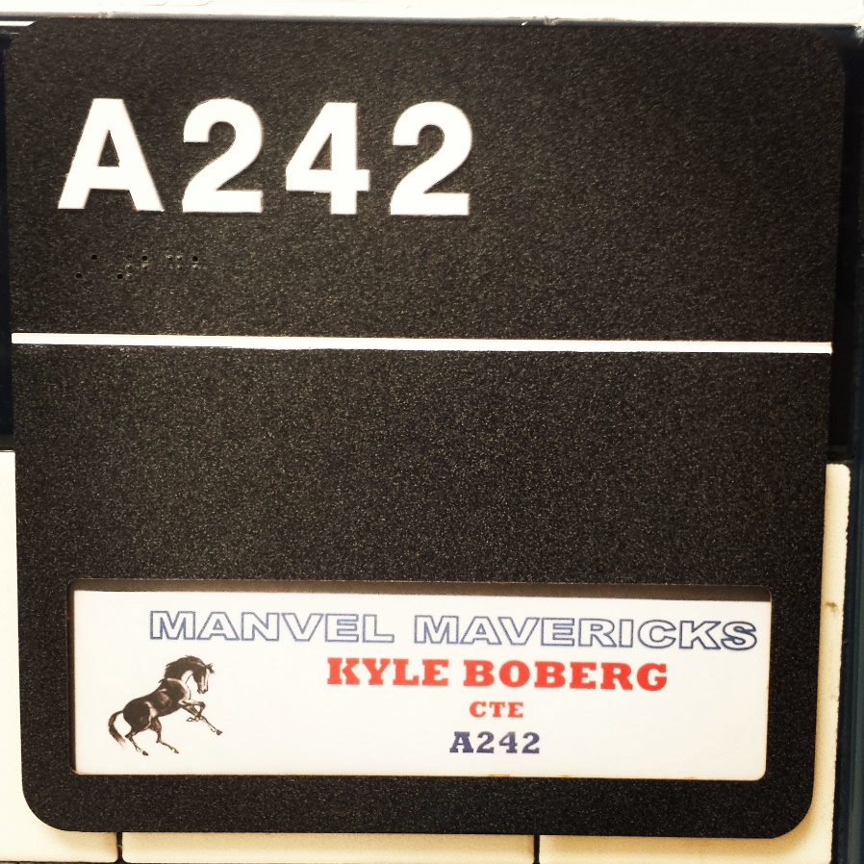
Am I in the right room?

Slide 4
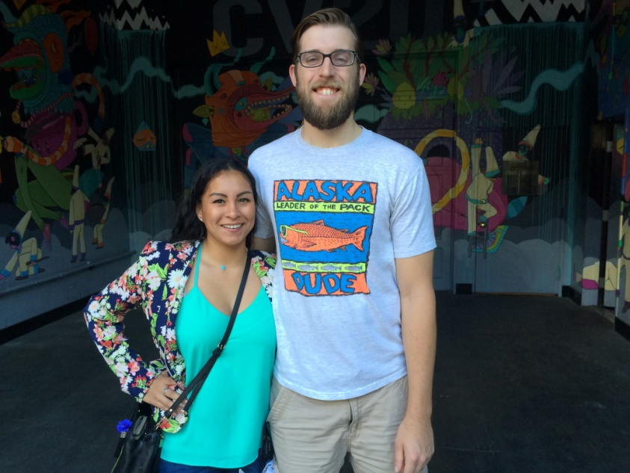
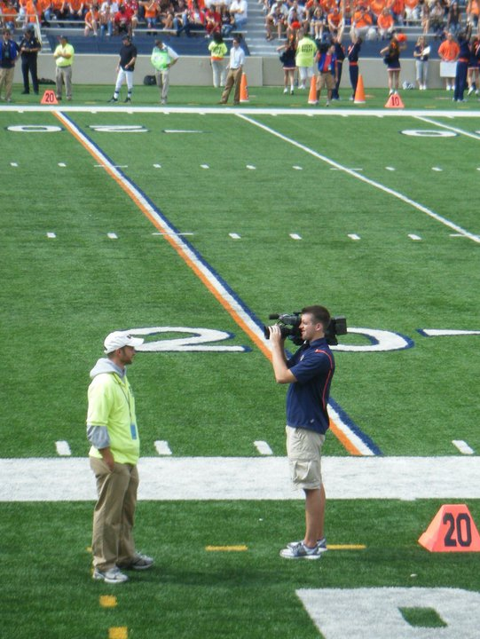
Who is Mr. Boberg?

Slide 5
Questions? Ask Me Anything!* *school appropriate

Slide 6
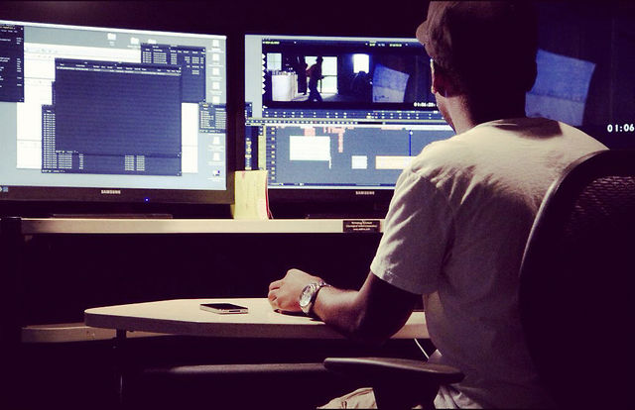
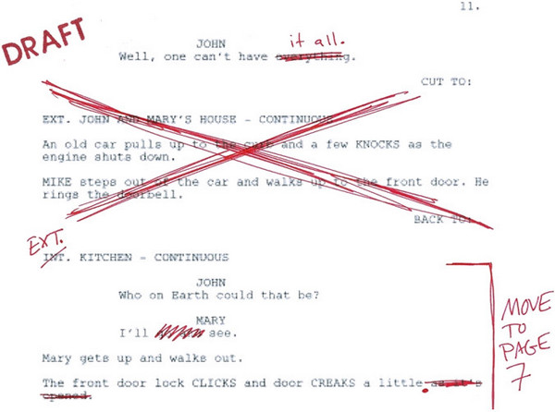
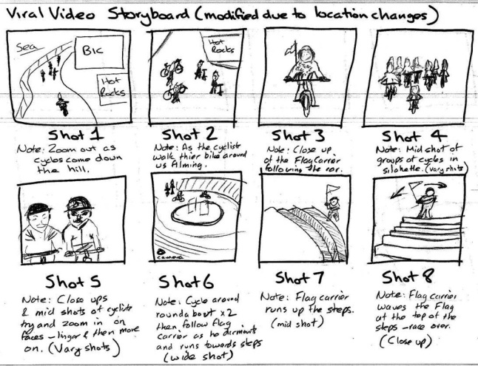
What you will be doing this semester:

Slide 7
You Will Need:
3 Ring Binder
Composition Notebook
Writing utensil
Headphones

Slide 8
Grading
Our Grading Scale
90-100= A
80-89= B
70-79= C
60-69= D
59 <= F
Grades are calculated on a cumulative percentage and will be rounded up whenever possible
Grading will be based on…
Notebook checks/quizzes – 20%
Participation –40%
Projects – 40%

Slide 9
Student Expectations
Be prompt and prepared.
Be ready when class begins.
Be polite
Speak in a normal tone of voice and always listen attentively.
Be positive
No putdowns and all criticism will be constructive.
Be productive
Turn in work on time and always do your best.
Be a problem solver
Correct problems quickly and peacefully before they escalate.

Slide 10
Show Respect
Value yourself.
Be honest and ethical and practice strong moral values
Treat everyone the way you want to be treated
Honor the ideas and opinions of others, even if you disagree
Always offer to help
Be responsible with equipment, property and your own belongings

Slide 11
Responsibility for Coursework
If you miss class, it is your responsibility to find out what you missed and come in after school and finish.
If it is not done by the time I have to finalize grades, it will be a 0.
I will not chase you around to make sure your work is done!

Slide 12
Questions?

Slide 13
Policies
Food and beverage are not allowed in the classroom or lab. ITEMS WILL BE THROWN AWAY IF BROUGHT IN.
Please already be seated and working when the bell rings.

Slide 14
Absences/ISS
- Most work will be done during class.
- You not being present will hurt your grade, unless there is a doctors note.
- Make up worksheets will be given if too many days are missed.
- Again, it is YOUR responsibility to communicate with me and get the work done.

Slide 15
Equipment
Students must have signed permission to use equipment.
If you misuse equipment, you will lose that privilege and may even be removed from class.
If you break equipment, you are responsible for repairs or replacement of broken equipment.

Slide 16
Following expectations will result in…
A stress free learning environment.
There will be enough stress learning new software and meeting all of our deadlines.

Slide 17
NOT following expectations procedures will result in…
Warning and in class documentation
Parent contact
Office contact
This class is meant to be fun. The less problems caused, the way more cool stuff we get to do.

Slide 18
How to be sent to the office IMMEDIATELY:
Fighting
Purposely damage school property or equipment
Lying, cheating or stealing
Blatant disrespectful behavior

Slide 19
Classroom Procedures
Entering the Room
Please enter quietly
Have a seat in your assigned seat or area
Begin work posted on the class website
Work quietly
When the bell rings I will instruct you what to do next

Slide 20
Classroom Procedures
If you are tardy:
You will be marked tardy if you enter after the 2nd bell. Passes are the only exception.
Sit in your assigned seat
Quietly listen to instructions that are in progress.
Wait until I am done speaking. Then you can ask a team member what you missed.
*There will be a grace period the first week*

Slide 21
Questions?

Slide 22
Classroom Procedures
Getting your attention
I will stand in front of class and ask that you listen
I will wait until everyone is quiet, then I will begin
If I turn off the lights, get quiet NOW
Again, the quicker everyone gets quiet, the quicker we get stuff done

Slide 23
Classroom Procedures
What if I finish work early?
Work on other homework from other classes.
Work on something quietly at your own computer.

Slide 24
Classroom Procedures
Scheduled Checkout
If you are going home early for any reason
Let me know as soon as possible
Please email me AND tell me at beginning of class

Slide 25
Classroom Procedures
Scheduled Checkout
Once it is time for you to leave
Quietly raise your hand to get my attention
Pack your materials quietly and leave at scheduled time
*If it is an emergency, quickly get my attention and I will assist you*
Because some projects will be outside the classroom, I don’t a call from the office asking you to leave and we can’t find you

Slide 26
Classroom Procedures
Turning in Assignments
Most assignments will be turned in electronically.
You will load your finished projects onto Google Drive (we will go over this in more detail later)
We will always watch and go over videos
Notes will be taken in your composition notebook
I will periodically check to see if you are taking notes and doing assignments
Any paper project will be turned in to me personally.

Slide 27
Classroom Procedures
Classroom Discussions
Please participate, but be quiet when someone else is talking. RAISE YOUR HAND and I will call on you to talk
I WANT to hear what you have to say!
Be sure to make all comments or questions relevant to our topic
If you have a question that is off topic, write it down and ask me after our discussion

Slide 28
Classroom Procedures
Moving Around the Room
You must ask permission by raising your hand.
Unless it is an emergency, please DO NOT ask during a classroom discussion.

Slide 29
Classroom Procedures
Class Dismissal
The teacher will dismiss you, NOT the bell
I will usually alert you that you have one minute to save anything and clean up your area.

Slide 30
Questions?

Slide 31
Classroom Procedures
Fire Drill
The fire drills route is posted near the front door
We will line up at the door and walk in a single file line. Follow me!
The last person out shuts the door and turns off the lights
I will take attendance outside. If you are not in line and do not respond, you will be counted as missing.

Slide 32
Cell Phones
You are not allowed to use your cell phone during discussions or when I am addressing class.
Charge your phone in the back of class.
If I see a phone you will get a warning. If I see it again I will take it and give it back at the end of class. If there is an argument, I will turn it into the office.
You may use your cell to listen to music while editing.

Slide 33
Working Together
In video production, teamwork is essential to success.
You don’t always have to like the person you are with, but you have to be courteous and fair with each in order to get the job done right.
I encourage you to work with other people besides your friends.
Challenging yourself and getting outside of your comfort zone will help you in this class, and more importantly, as a person.

Slide 34
Filming Outside the Classroom
Students will follow all Handbook Rules.
Address all adults with respect
Please be mindful of the time and return with enough time to load your footage and put everything away when you are finished.
Being late will deduct points from your grade.
We do this to make sure the equipment is returned and in working order. Others need to use it!

Slide 35
Equipment Room
Everything in this room has its place. We must keep it organized and always know where equipment is at all times.
You will be trained on how to use this room properly. No one is allowed in the room unless you are assigned to work it.
Each of you will be assigned a two week period where you are in charge of equipment.
If equipment is missing and you signed it out, you are responsible. If it is missing and it is not signed out, those in charge of the room are responsible!

Slide 36
Field Trips
Depending on how the semester is going, we may take field trips throughout the year.
All trips have cost involved. When the time comes, I will address how much it will be.

Slide 37
Special Guests
We may have special guests that work in the industry from time to time.
Please treat them with the respect they deserve or we will not have guests.
If it is a presenter, listen intently until they are finished. Then you may ask questions.
If there is a substitute, nothing changes except harsher consequences if any rules or procedures are broken.

Slide 38
My Pledge to Students
I will always trust you until you give me a reason not to.
I will respect you and work with you to solve any problems.
I will always give constructive criticism and feedback on your work.
I will work with you to meet your goals.
I will offer extra help after school if you ask.
I will always strive to do what is best for you. I will never intentionally hurt your feelings just because. Everything I say or do is to make you better.

Slide 39
Questions?

Slide 40
NOW LETS GET STARTED!

Slide 41
1. Finish Questionnaire 2. Create your Google Drive folder 3. Sign up for Remind 101

